Slide 1
QUECHUAS

Slide 2
PRONUNCIATION: KECH-wah
LOCATION: Peru; Ecuador; Bolivia (Central Andes regions)
POPULATION: About 7.5 million
LANGUAGE: Quechua language
RELIGION: Combination of pre-Columbian and Roman Catholic beliefs

Slide 3
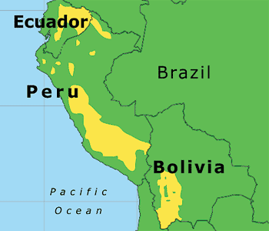

Slide 4
Introduction:
The Quechas are the descendants of the Inca empire which was conquered by the Spaniards in the 16th century
Quechas tribe also known as Runakuna, Kichwas, and Ingas is an ethnic group in South America, especially in Peru, Ecuador, Bolivia, Chile, Colombia and Argentina

Slide 5
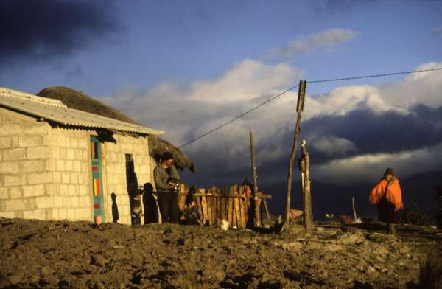
Quechuas live in adobe houses with no windows. At night they close the one door but in the daytime it is left open to provide ventilation. Near the main house is another smaller house which is used to do the cooking and eating. Often it is also used for raising guinea pigs, a food saved for special occasions.

Slide 6
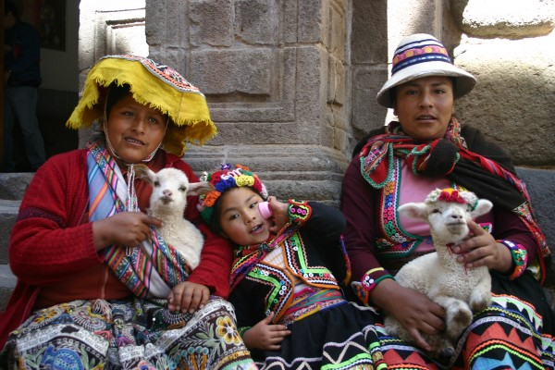

Slide 7
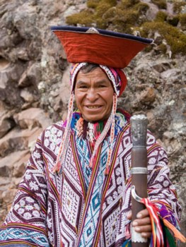
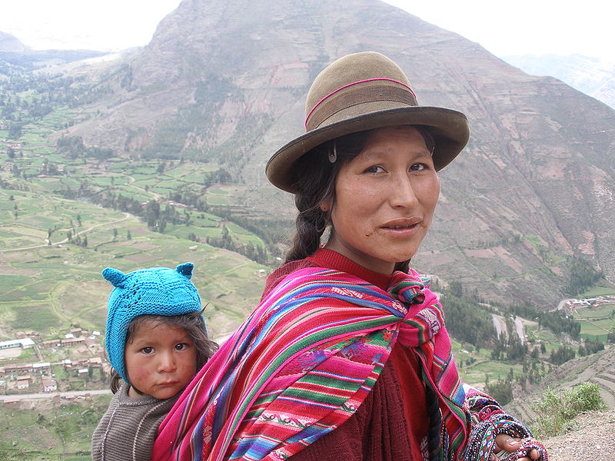
Most Quechuas live in a cool climate and wear heavy clothing. The women spin the woolen thread from sheep, llamas, and alpacas. The men weave the material to make trousers, ponchos, heavy colorful skirts, and "mantas", similar to a shawl. Women wear several skirts at the same time - as many as fifteen for special occasions. The number of skirts worn may indicate one's relative importance in the community.

Slide 8
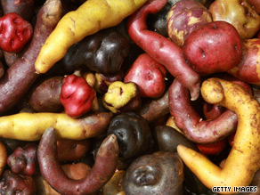
Food:
The potato was first domesticated in Peru approximately 4,500 years ago. The potato and quinoa grain remain as two of the main staples of the Quechua diet. Common dishes include meat or potato stews, spiced with hot peppers, coriander, or peanuts. For community feasts, a pachamanca, or underground oven, is occasionally used.

Slide 9
Language:
The Quechua language is known by its speakers as Runa Simi, or the language of the people. The term quechua refers more to the language than to a concrete ethnic group. The Quechua language was the administrative language of the Inca state. It is spoken by millions of people in Peru (about 8 million), Ecuador (nearly 2 million), and Bolivia (about 1 million).

Slide 10
Clothing:
K’eperina - a large rectangular cloth worn over the back and knotted at the front. Used to carry children, small animals, and goods.
Juyuna – a wool jacket decorated with buttons. Under it, women use a tight-fitting synthetic sweater, usually in bright shades of yellow, pink, and green.
Polleras – dark colored skirts adorned with colorful details made from hand-woven wool cloth called bayeta. Women may wear 3 or 4 skirts in layers.
Monteras – traditional hats. They vary drastically throughout the tribes and communities in the Andes. Hats are secured with delicately woven sanq’apa straps adorned with white beads.
Unkuña – a small rectangular cloth that is used for carrying snacks such as corn or coca.
Ojotas – sandals made from recycled truck tires.

Slide 11
GRACIAS
Presented by:
Riya, Devyani, Vishal & Smriti

