Slide 1
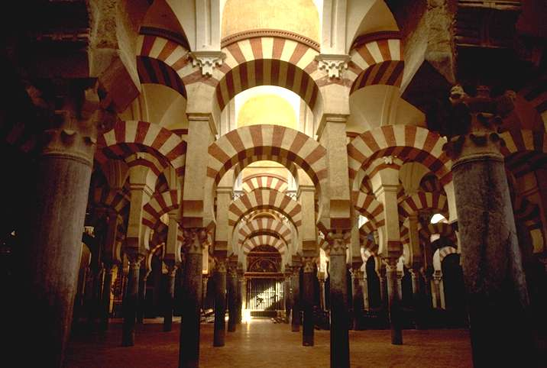
MUSuLMANA IN SPAIN

Slide 2
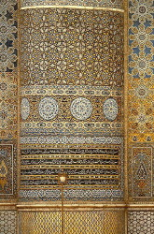
Islam has had a fundamental presence in the culture and history of Spain. The religion was present in modern Spanish soil from 709 until 1614 beginning with Arab rule and ending with the expulsion of the Moriscos of Al-Andalus.

Slide 3
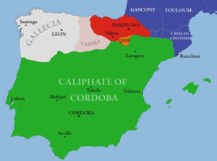
Al Andalus
also known as Moorish Iberia or Islamic Iberia, was a medieval Muslim state occupying at its peak most of what are today Spain, Portugal, Andorra, and part of southern France. The name more generally describes parts of theIberian Peninsula and Septimania governed by Muslims at various times between 711 and 1492, though the boundaries changed constantly in wars with Christian kingdoms.[

Slide 4
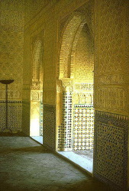
Granada – The Last Muslim Kingdom of Spain
Once a diminutive Islamic city now has several recognizably Western buildings, built in the century following the fall of Granada to the Catholic Monarchs in 1492.

Slide 5
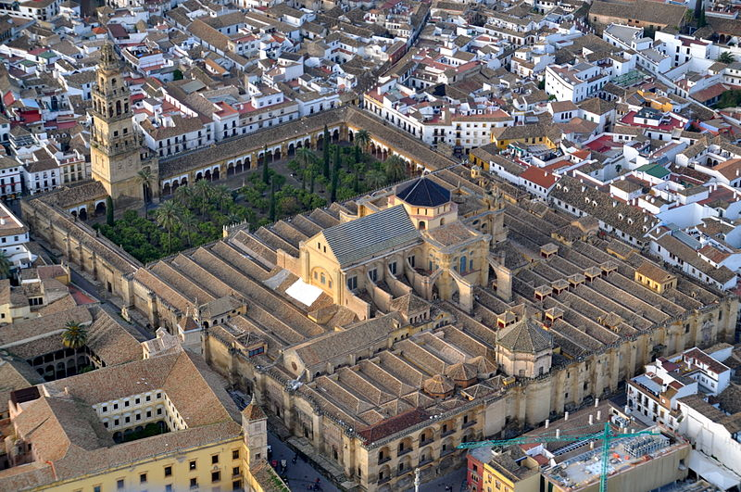
Cathedral of Cordoba
The exterior of the Cathedral of Cordoba, formerly the Great Mosque of Córdoba. The cathedral is one of the finest examples of Arab-Islamic architecture in the Umayyad style. An Islamic Mosque (742) built on the site of the Visigothic Christian 'Saint Vincent basilica' (600) then reconquered for the Christian Cathedral de Nuestra Señora de la Asunción in 1236.

Slide 6
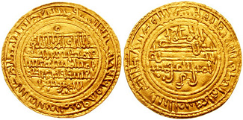
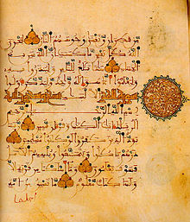
Gold Dinar
A manuscript page of the Qur'an in the script developed in Al-Andalus, 12th century

Slide 7
BY- ARSHIT SAMARTH CHITMAN AND MARK
GRACIAS

