Slide 1
tipos de Tapas Karan Chaudhary – 9B3
Types of Tapas

Slide 2
1)Boquerones en vinagre
Fresh fillets pickled in vinegar with salt and garlic, best made home made in the fishing ports of Andalusia and Levante. Small and oily-fleshed, anchovies, have a short shelf-life; the treatment adds a few days’ grace, a practical response to lack of refrigeration in a hot climate. Serve drained from the pickle, dressed and topped with garlic, chopped parsley and a thread of Olive oil.
Filetes encurtidos en vinagre con sal y ajo. Hecho casero en los puertos pesqueros de Andalucia y Levante. Servado drenado de la salmuera con el ajo, el perejil picado y pequenas aceitas de olivia.

Slide 3
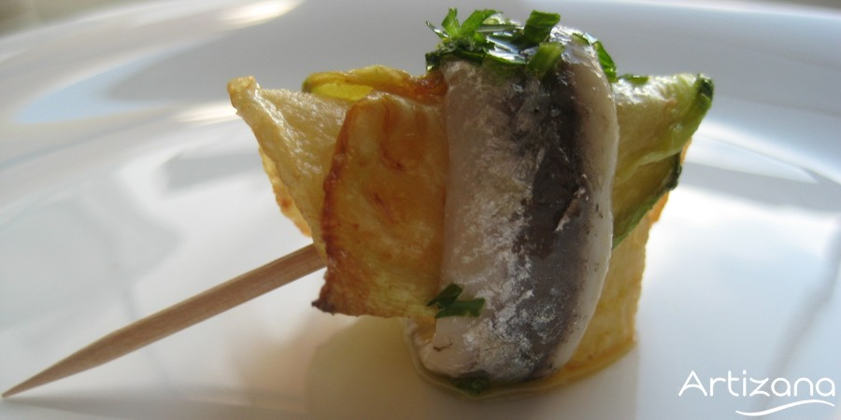

Slide 4
2) Patatas Bravas
small potato pieces, deep-fried, boiled, or sautéed, spicy, with tomato and garlic. Cheap, the simplest and most economical of tapas. Invented by the Bar Tomas in the Sarria district of Barcelona, a very famous place.
Pequenos pedazos patatas, fritos o hervidos, picante con tomate y ajo.

Slide 5
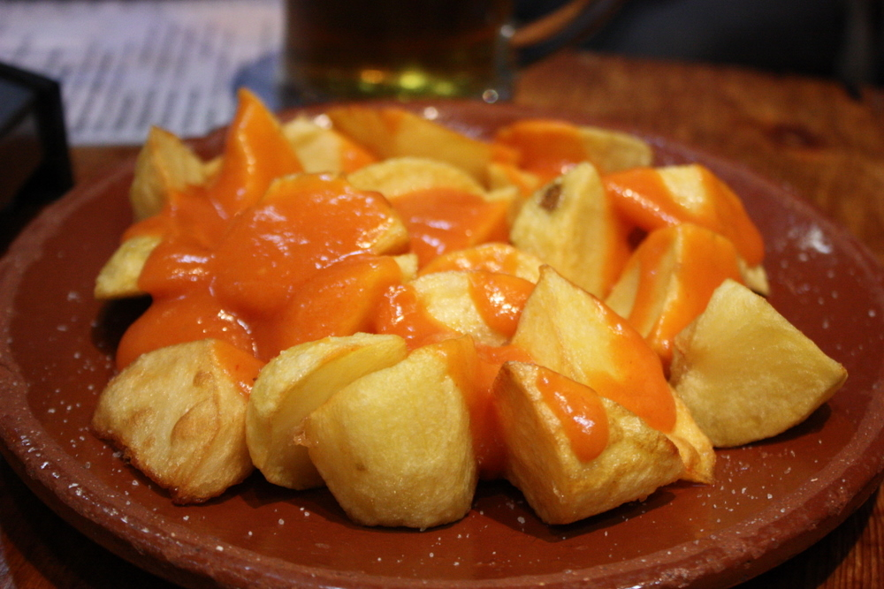

Slide 6
3) Pinchitos moruños (Moorish kebabs)
small meat pieces marinated in oil, garlic, spices- cumin, coriander, sometimes turmeric . A specialty of Andalusia.
Pequenos trozos de carne marinados en aceite, ajo, Especias- comino, cilantro, curcuma veces.

Slide 7
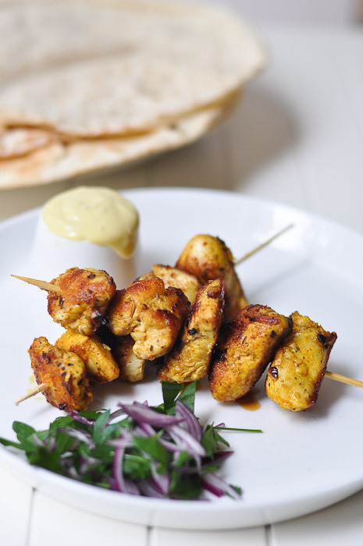

Slide 8
4) Albondigas en salsa
Little pork and beef meatballs, covered by a sauce which is based on gently spiced tomatoes , or parsley, or saffron and almonds.
Pequeno cerdo y albondigas de carne, cubierto por una salsa que se hace por los tomates especiados suavmente, o perejil, o el azafran almendras.

Slide 9
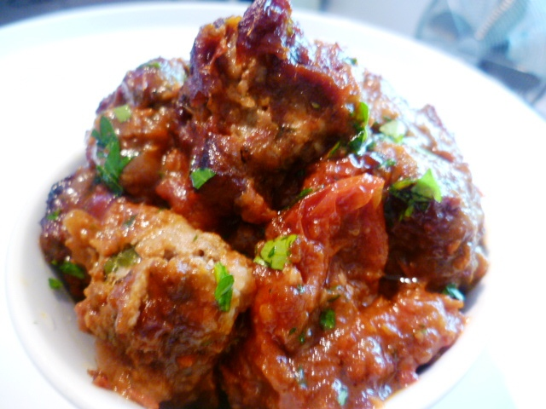

Slide 10
Gracias!
By Karan Chaudhary

